Slide 1
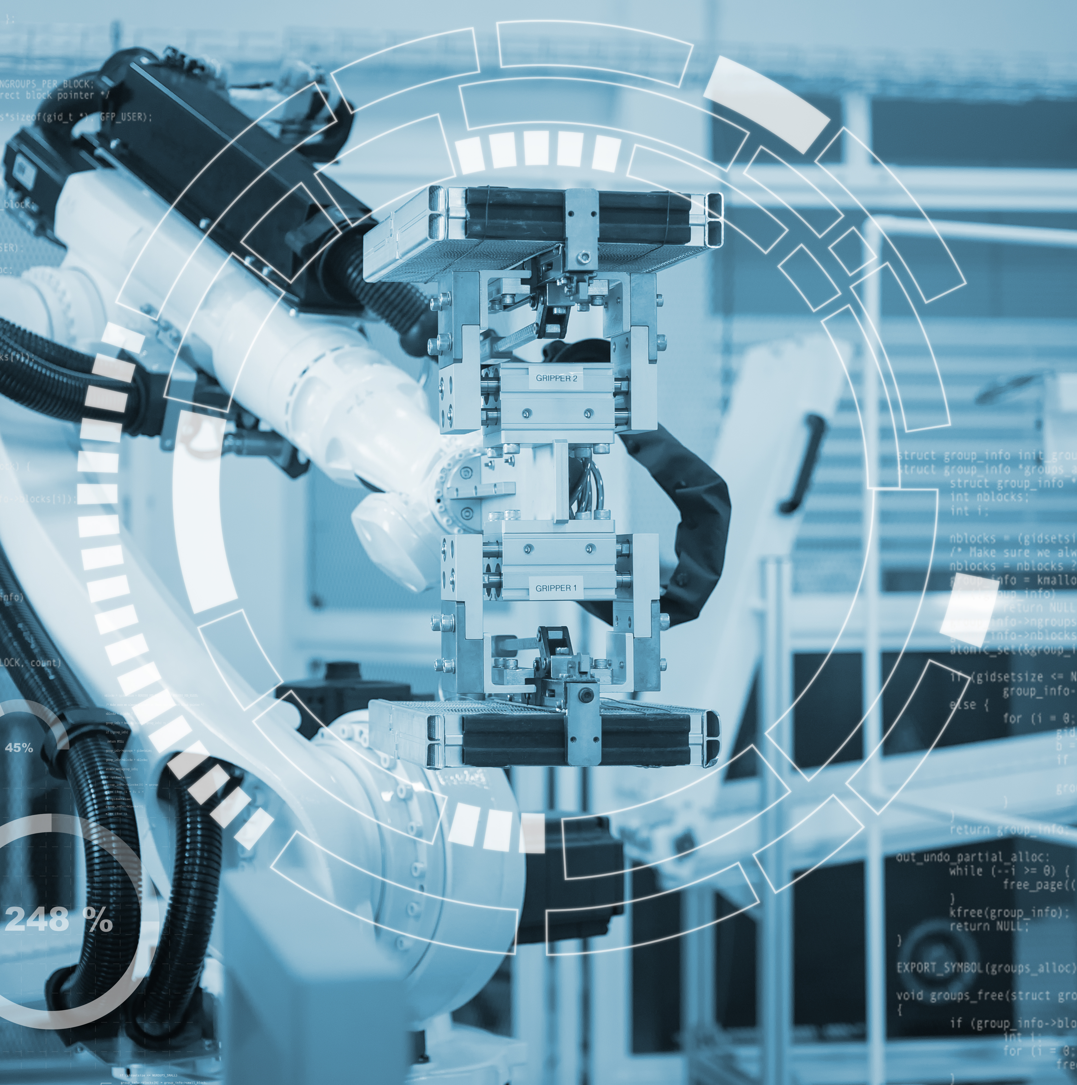



TEAM BATH HYDROBOTICS WORKSHOP
In collaboration with Bath Computer Science Society
X
Notes:
- Welcome everyone and thank BCSS for hosting
- Brief self-introduction (name, role on the team)
- "Today we're going to show you some of the hardest problems in computer vision - and let you have a go at solving them"
- Mention this is collaborative: Hydrobotics + BCSS

Slide 2
Who we are
Notes:
Transition: "Before we dive into the technical stuff, let me tell you who we are"

Slide 3
Team Bath Hydrobotics
University of Bath student team competing in the MATE ROV Competition
Building underwater robots (ROVs) that perform real-world tasks
Competing internationally in St. John's, Newfoundland, Canada (June 2026)
Multidisciplinary team: mechanical, electrical, and software engineering
Working with real sponsors and industry partners
Notes:
- "We're a student-run team that builds underwater robots"
- Explain what an ROV is: "Remotely Operated Vehicle - basically a drone but underwater"
- "We compete internationally - this June we're heading to Newfoundland, Canada"
- "The team is multidisciplinary - we have mechanical engineers building the frame, electrical doing the power systems, and software doing everything from control systems to computer vision"
- Mention you work with real sponsors/industry

Slide 4
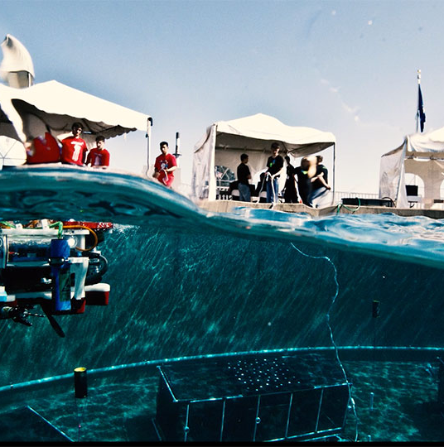
The MATE ROV Competition
World's largest underwater robotics competition
Tasks simulate real ocean industry challenges:
Underwater coral reef 3D modelling and measurement
Marine life detection and classification (crabs, fish species)
Iceberg tracking and monitoring
Underwater infrastructure inspection
Judged on mission completion, technical documentation, and safety
Notes:
- "MATE is the world's largest underwater robotics competition"
- "The tasks simulate real ocean industry work"
- Go through tasks briefly:
- "Coral 3D modelling - recreate reef structure from video"
- "Marine life detection - count and classify species"
- "Iceberg tracking - monitor position and movement"
- "Infrastructure inspection - find damage underwater"
- "We're judged on actually completing missions, but also technical reports and safety"

Slide 5
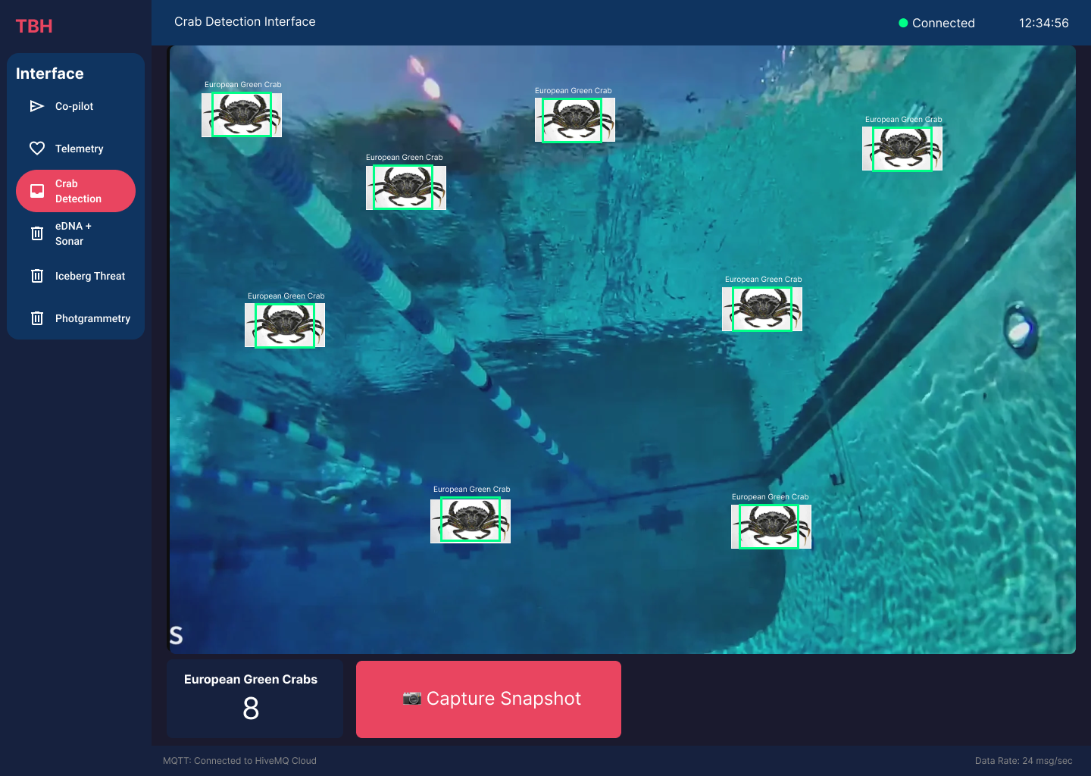
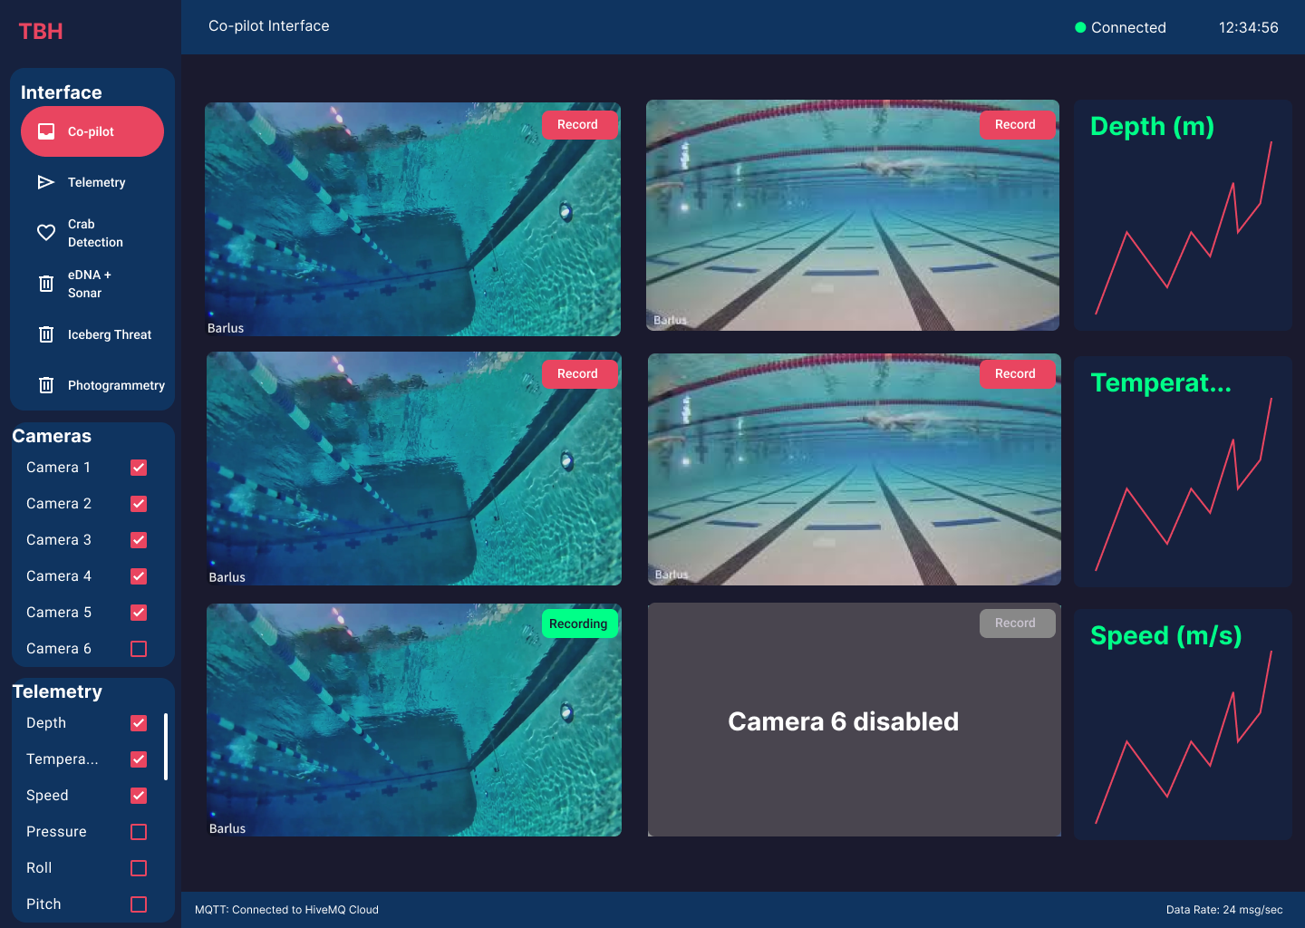
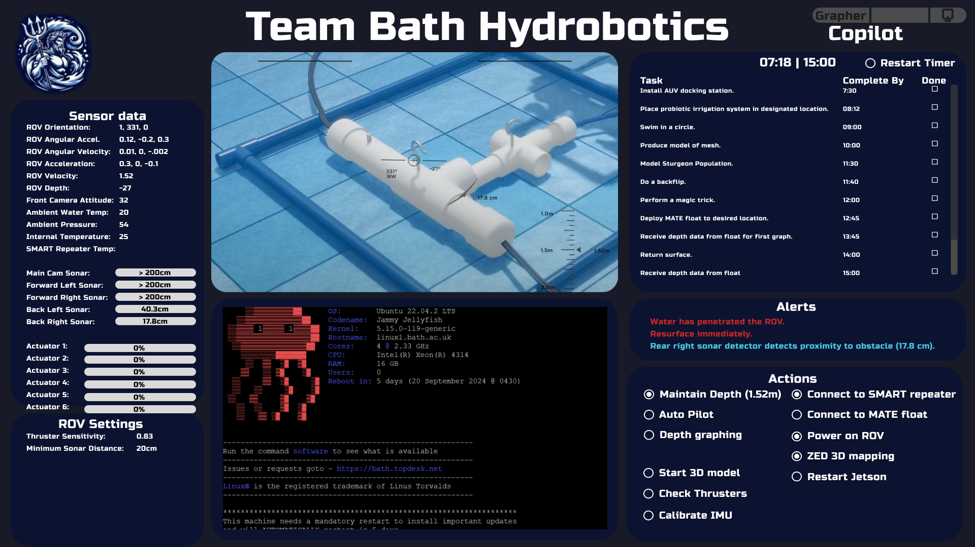
The Software Team’s Role
Multi-camera video streaming with minimal latency
Real-time computer vision for object detection
Control systems for precise ROV movement
User interface for pilot operation
Data logging and telemetry systems
Autonomous navigation capabilities
Notes:
- "This is where you come in"
- Go through each bullet:
- "Multi-camera streaming - our ROV has 4+ cameras, all need to stream with minimal delay"
- "Real-time CV - we need to detect and track objects live"
- "Control systems - convert pilot input into precise movements"
- "User interface - the pilot needs to see everything at once"
- "Telemetry - know what's happening inside the robot"
- "Autonomy - we're building features for the ROV to operate independently"

Slide 6
Technical Deep Dive
Notes:
"Now let's get into the fun part - why this is actually hard"

Slide 7
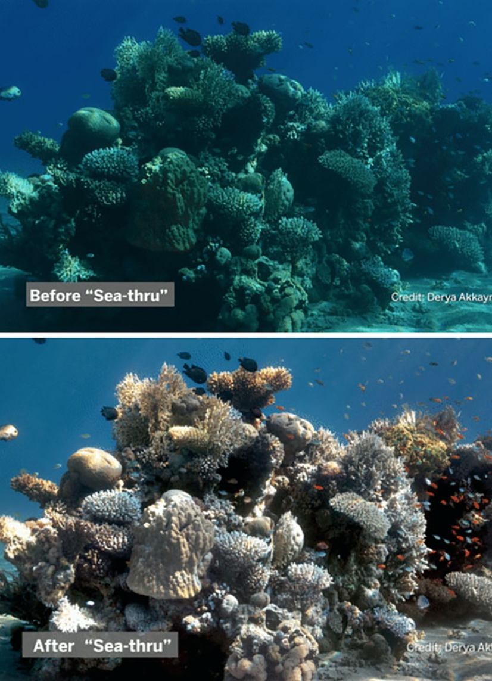
Why Underwater Vision is Difficult
Light absorption: Red light disappears first, everything looks blue-green
Turbidity: Suspended particles reduce visibility dramatically
Backscatter: Light reflects off particles creating noise
Light scattering: Objects appear blurred at distance
Uneven lighting: ROV-mounted lights create shadows and glare
Low contrast: Objects blend with murky backgrounds
Notes:
- "Underwater, physics works against you"
- Light absorption: "Red light gets absorbed first - everything looks blue-green. That's why underwater photos look weird without correction."
- Turbidity: "Particles in the water reduce visibility. Sometimes you can only see 2 metres ahead."
- Backscatter: "Your lights illuminate the particles, creating noise - like driving through fog with high beams"
- Light scattering: "Objects look blurry because light bounces around"
- "On top of that, your ROV lights create harsh shadows"

Slide 8
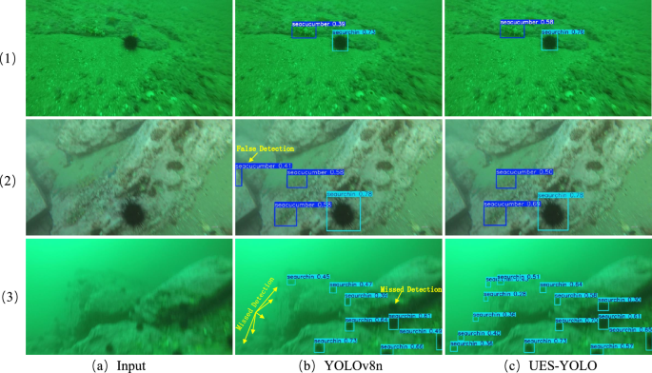
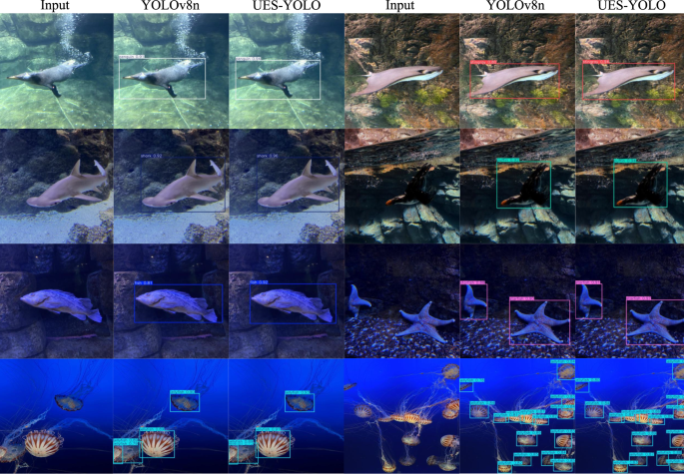
When Machine Learning Breaks
Domain shift: Models trained on clear images fail underwater
ImageNet has millions of cats and dogs, almost no underwater images
Limited training data for underwater environments
Transfer learning doesn't always transfer well
Need specialised approaches: data augmentation, domain adaptation
Classical CV techniques sometimes outperform deep learning here
Notes:
- "So why not just use AI? That's what everyone says."
- Domain shift: "Models trained on ImageNet - cats, dogs, cars - don't know what underwater looks like"
- "There are millions of labelled images of everyday objects, almost none of underwater scenes"
- "Transfer learning - where you take a pretrained model and fine-tune it - sometimes works, sometimes doesn't"
"This is where it gets interesting: sometimes classical computer vision techniques from the 90s outperform deep learning underwater”
"Who here has used a pretrained model before? PyTorch, TensorFlow?" (hands)
"The assumption is that pretraining helps. Underwater, that assumption breaks."

Slide 9
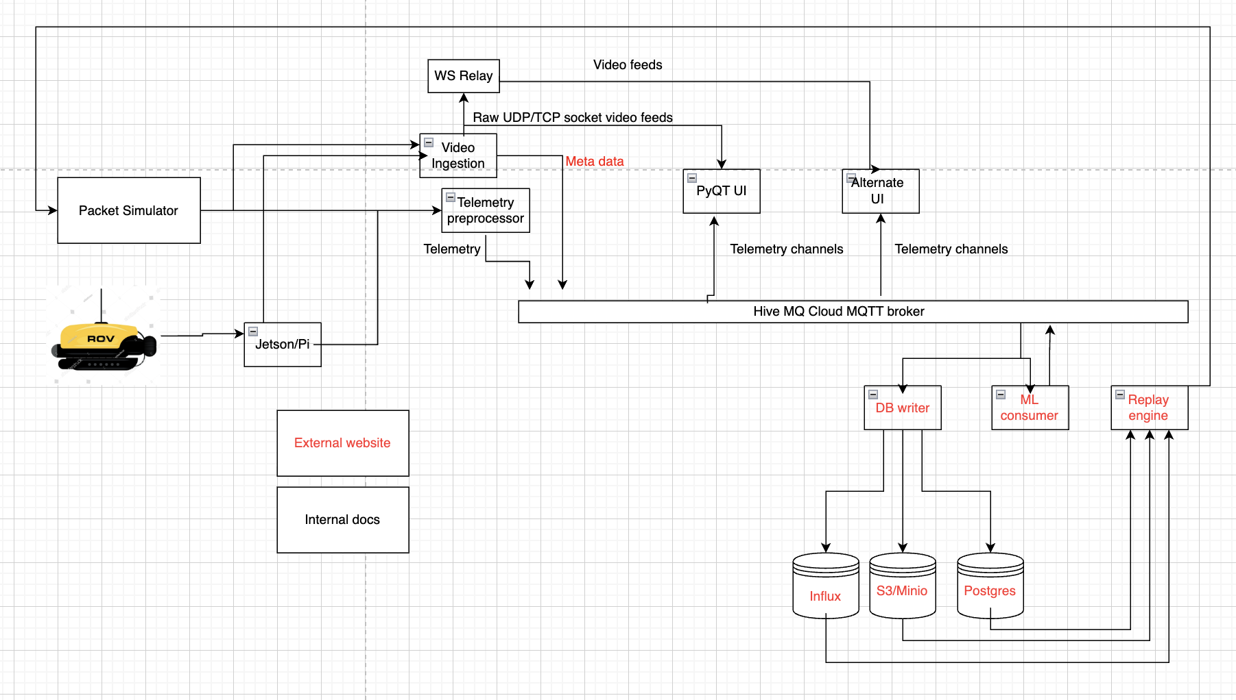
Building Real-Time Systems
Multi-camera pipeline: 4+ cameras streaming simultaneously
Low latency requirement: <100ms for responsive control
Back pressure: What happens when processing can't keep up?
Unreliable network links: ROV connected via tether
Safe control loops: ROV must fail safely if connection drops
Collaborative development: Team with varying experience levels
Notes:
- "Computer vision is only half the battle"
- "We have 4+ cameras. They all need to stream at 30fps with less than 100ms delay"
- Back pressure: "What happens when your processing can't keep up with the camera? You drop frames, buffer overflows, system crashes"
- "The ROV is connected via a tether - if that connection drops, the ROV needs to fail safely"
- "And we're a student team - people have different experience levels, different schedules. We need to build systems that everyone can contribute to"

Slide 10
Workshop Tracks
Notes:
"Enough talk. Let's get you building."

Slide 11
Choose Your Challenge
Starter Track
Systems Design
AI/ML Track
Beginner
Intermediate
Advanced
Learn CV fundamentals from scratch
Design architecture for autonomous ROVs
Build neural networks and detect objects
Notes:
- "We have three tracks based on your experience and interests"
- Point to each:
- "AI/ML for those who want to get into neural networks and object detection"
- "Systems Design for those interested in architecture - no coding required"
- "Starter for anyone new to Python or computer vision"
- "You'll work in teams of 1-4"
- "At the end, each team presents their approach - not their code, their thinking"

Slide 12
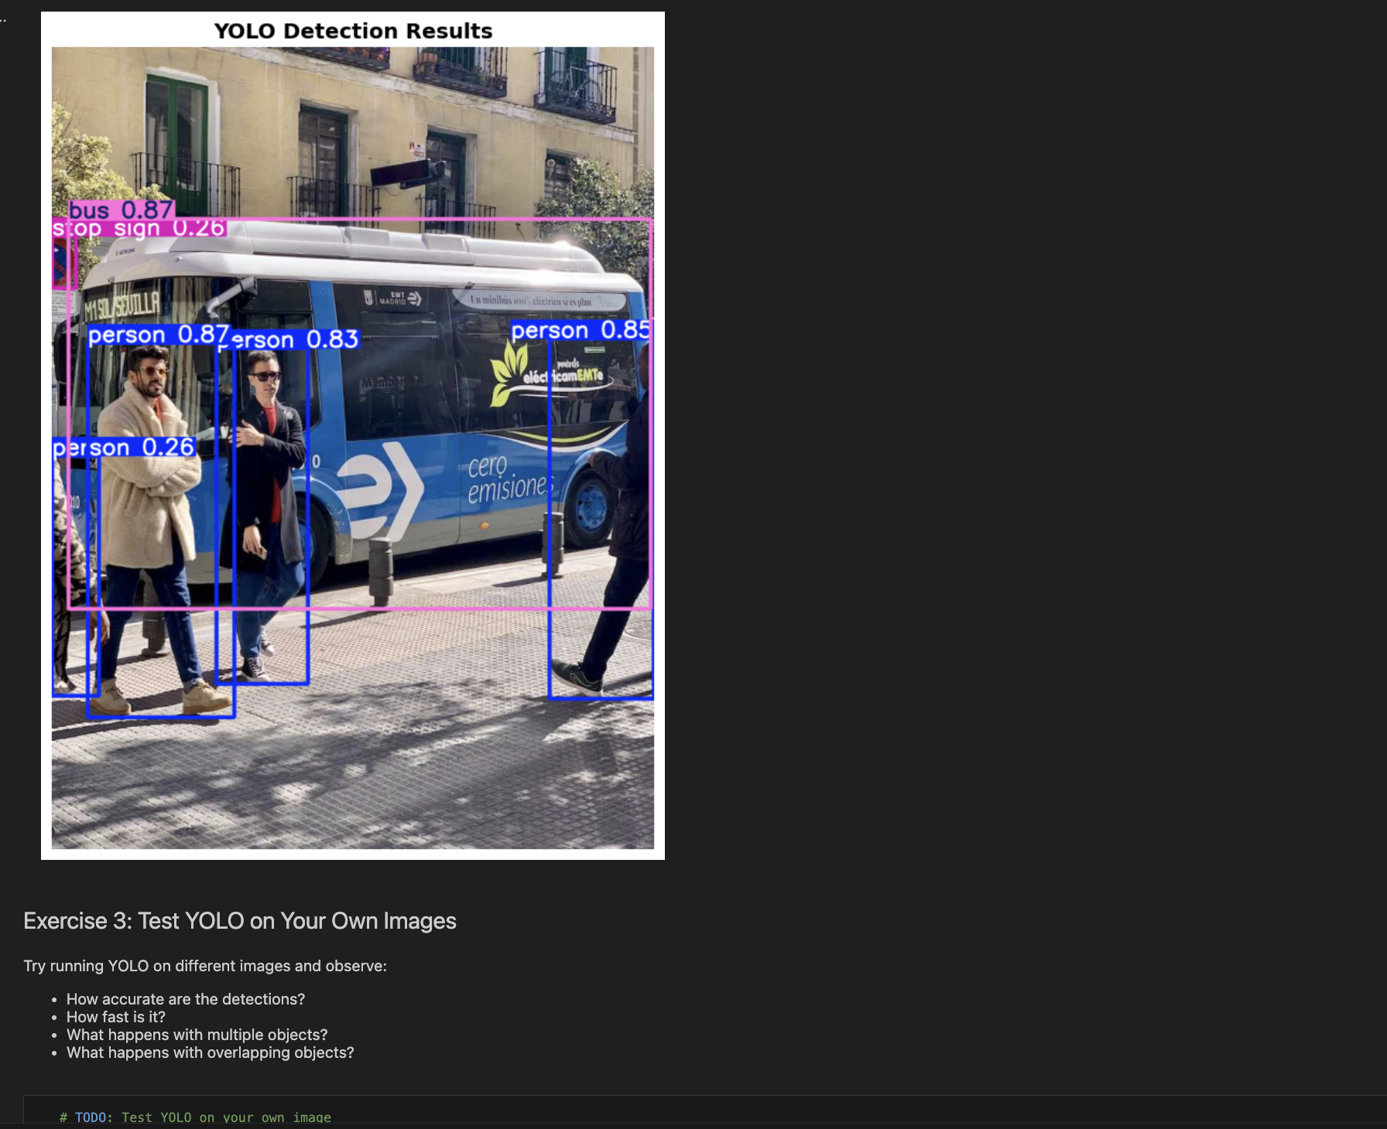
Track 1: AI/ML – Object Detection
What you will do:
Work in teams of 1-4
Tackle underwater crab detection challenge
Brainstorm and design solutions
Present your approach to the group
What you will learn:
Neural network fundamentals
CNN architecture and convolutions
YOLO real-time object detection
Underwater CV challenges
What is provided:
Jupyter notebook with guided exercises
Pre-trained YOLO models
Sample underwater images
Evaluation code for testing
Notes:
- "The AI track is for those who want to understand how neural networks actually work"
- What you'll do:
- "Build neurons and networks from scratch in NumPy - no black boxes"
- "Implement convolution operations manually before using PyTorch"
- "Use YOLO for real-time detection"
- "Tackle our crab detection challenge"
- What you'll learn:
- "How CNNs actually work - not just how to call model.fit()"
- "Why certain architectures exist"
- "How to think about underwater-specific problems"
- "We provide a full Jupyter notebook with code and explanations"

Slide 13
Track 2: Systems Design
What you will do:
Analyse our current ROV architecture
Identify bottlenecks and improvements
Design multi-ROV streaming solutions
Propose autonomous operation architecture
What you will learn:
Systems architecture thinking
Real-time data pipeline design
Fault tolerance strategies
Security and access control
What is provided:
Architecture diagram of current system
Design questions and prompts
Diagramming tools (Mermaid, Draw.io)
Mentor support for discussions
Notes:
- "Systems track is for those who like thinking about architecture"
- "No coding - this is about design and reasoning"
- What you'll do:
- "We give you our current architecture diagram"
- "You identify bottlenecks, single points of failure"
- "Design improvements for multi-ROV operation, autonomy"
- Questions you'll tackle:
- "What happens if the message broker goes down?"
- "How do you handle losing connection to the ROV?"
- "How do you secure communications?"
- "Use Mermaid or Draw.io for diagrams - we want to see your thinking"

Slide 14
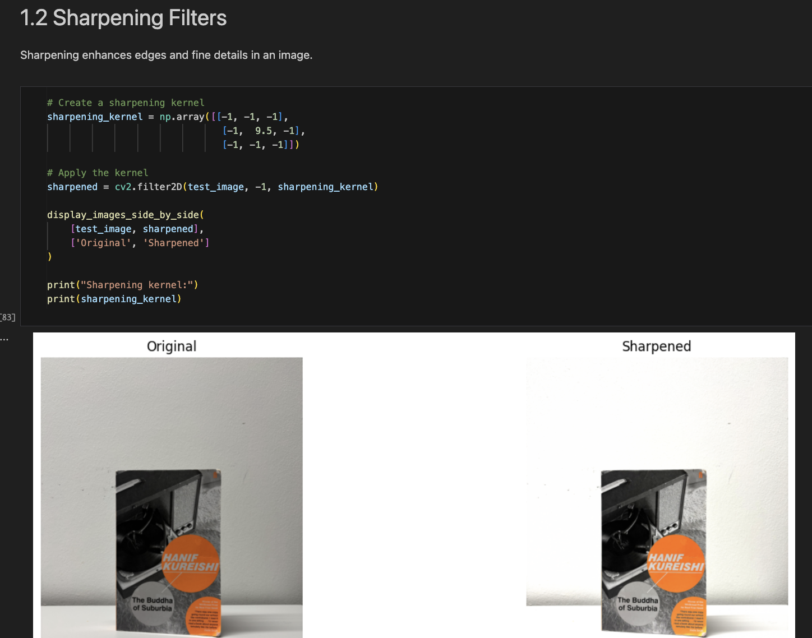
Track 3: Vision Fundamentals
What you will do:
Learn image processing from scratch
Apply filters and transformations
Detect edges in images
Build a real-time vision pipeline
What you will learn:
OpenCV basics
Image filtering (blur, sharpen)
Edge detection (Canny, Sobel)
Back pressure and telemetry
What is provided:
Step-by-step Jupyter notebook
Sample images included
Clear explanations for each concept
Optional advanced challenges
Notes:
- "Starter track is for anyone new to computer vision - or Python in general"
- "This is not a lesser track - these fundamentals matter"
- What you'll learn:
- "Image filtering - blur, sharpen, noise removal"
- "Transformations - rotate, scale, how images move in memory"
- "Edge detection - the building blocks of object detection"
- "Back pressure - how to handle real-time data"
- "Telemetry - monitoring your system's health"
- "Everything is in a step-by-step notebook. Run a cell, see what happens, understand why."
- "If you finish early, there are bonus challenges"

Slide 15
Challenge Details
Notes:
"Let me give you more specifics on what you'll actually be doing"

Slide 16
AI Track: The Crab Detection Challenge
Goal: Detect crabs in challenging underwater footage
Constraints:
Limited compute (laptop only, no cloud GPU)
Noisy data with uneven lighting
Low contrast between crabs and seafloor
Real-time performance desired
Approaches to consider:
Classical CV (SIFT, RANSAC)
Pre-trained CNN with fine-tuning
Custom preprocessing pipelines
Notes:
- "Your goal: detect crabs in challenging underwater footage"
- Constraints:
- "Laptop compute only - no cloud GPUs"
- "The data is noisy, lighting is uneven"
- "Crabs blend into the seafloor - low contrast"
- "We want something that could run in real-time"
- Approaches to consider:
- "Classical CV - SIFT features, RANSAC matching"
- "Pretrained CNN with domain adaptation"
- "Heavy preprocessing to normalise lighting"
- "Something completely different"
- "There's no single right answer. We want to see your reasoning."

Slide 17
Systems Track: Architecture Challenges
Questions to tackle:
Where are the bottlenecks in our current design?
How would you handle multiple ROVs simultaneously?
What changes for autonomous operation?
How do you handle broker/connection failures?
What's the data management strategy?
How do you secure ROV communications?
Notes:
- "You'll be given our architecture diagram and these questions"
- Walk through each:
1. "Bottlenecks - where does data pile up? Where are the slow paths?"
2. "Multi-ROV - how do you scale to 2, 3, 10 ROVs?"
3. "Autonomy - what new components do you need? How does the surface station change?"
4. "Fault tolerance - what's your recovery strategy?"
5. "Data management - what do you store? For how long?"
6. "Security - who can control the ROV? How do you prove identity?"
- "Pick whichever questions interest you most"

Slide 18
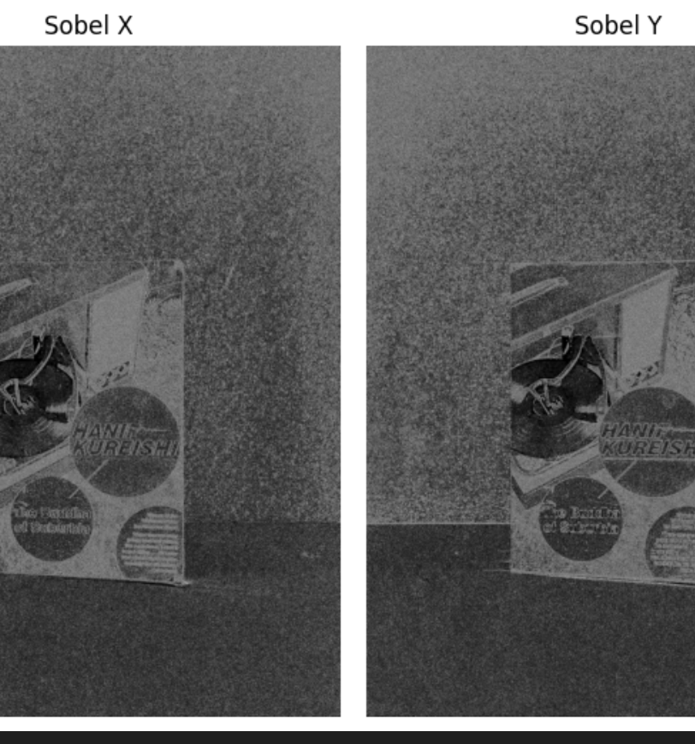
Starter Track: Vision Pipeline
Part 1: Image Filters
- Blur (Gaussian, Median), Sharpening
Part 2: Transformations
- Rotate, Scale, Translate images
Part 3: Edge Detection
- Canny, Sobel, Laplacian operators
Part 4: Back Pressure
- Handle real-time data flow
Part 5: Telemetry
- Monitor system performance
Notes:
- "The starter notebook is divided into five parts"
- Walk through quickly:
- "Part 1: Filters - smooth out noise, sharpen edges"
- "Part 2: Transformations - rotate and resize images correctly"
- "Part 3: Edge detection - three different algorithms, compare results"
- "Part 4: Back pressure - simulate a camera producing faster than you can process"
- "Part 5: Telemetry - track your system's FPS and processing time"
- "By the end, you'll have a complete SmartVisionPipeline class"
- "The bonus challenge: modify it to handle your own use case"

Slide 19
Getting Involved
Notes:
"Before we split up, let me tell you about what comes next"

Slide 20
What We’re Looking For
Time commitment: ~5-10 hours per week during competition season
Skills we need:
- Python developers (any level)
- CV/ML enthusiasts
- Systems architects
- UI/UX designers
- Anyone willing to learn!
No robotics experience required - we'll teach you everything
Notes:
"We're actively recruiting for next season"
- Time commitment: "About 5-10 hours a week during competition season, less during term"
- Skills we need - emphasise variety:
- "Python developers at any level"
- "CV/ML enthusiasts who want to go deeper"
- "Systems thinkers who like architecture"
- "UI/UX people - the pilot interface matters"
- "Anyone willing to learn"

Slide 21
Next Steps
1
Complete today's workshop
Get hands-on with the challenges
2
Chat with us after
Ask questions, meet the team
3
Join our Whatsapp community
[QR Code]
4
Come to our next meeting
[INSERT DATE/LOCATION]
Notes:
- "Here's what happens after today"
1. "Complete the workshop - get hands-on with the challenges"
2. "Chat with us - we'll be around during and after"
3. "Join our Discord - where all the coordination happens" [point to link]
4. "Come to our next meeting" [give date/location]
- "If you do well today and you're interested, we may reach out directly"

Slide 22
Thank You
X
Notes:
- "That's the intro. Any questions before we split into tracks?"
- Pause for questions (1-2 minutes max)
- "Alright, let's build something"
- Direct people to their tracks
- Make sure mentors are available for each track

